Slide 1
Route Tables & NAT Gateways
Directing Traffic

Slide 2
Route Tables
Route traffic within your VPC, subnet, CIDR range, IGW
When you create a VPC you get a ‘Main’ route table by default
By default ’Main’ doesn’t allow traffic to/from the internet
You can create an additional route table for your public routes/subnet
Every subnet gets an associated route table (defaults to main, so don’t put your public routes in main)
Notes:
Good extra reading: https://docs.aws.amazon.com/vpc/latest/userguide/vpc-nat-gateway.html

Slide 3
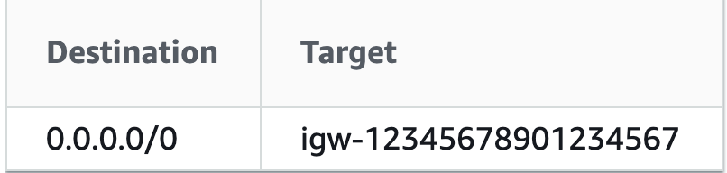
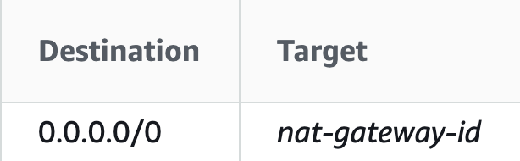
Example
Destination
Defines WHAT traffic
Target
Defines WHERE traffic can travel via
0.0.0.0/0 represents all routes not already defined

Slide 4
Give’s the public subnet internet access
Give’s the private subnet access to their on-prem infra

Slide 5
NATGW
Network Address Translation – translates private IP’s to IP’s that the internet can understand
Managed by AWS
Sits in the Public subnet with an EIP (Elastic IP) or a public IP

Slide 6
Give’s the private subnet access to the internet via the NATGW

Slide 7
What are we creating today?
Your Public Subnets routes internet traffic via your Internet Gateway (Public Route Table)
Your Private Subnets routes internet traffic via your NAT Gateway, which then forwards traffic out the Internet Gateway (Main/Default or Private Route Table)

Slide 8
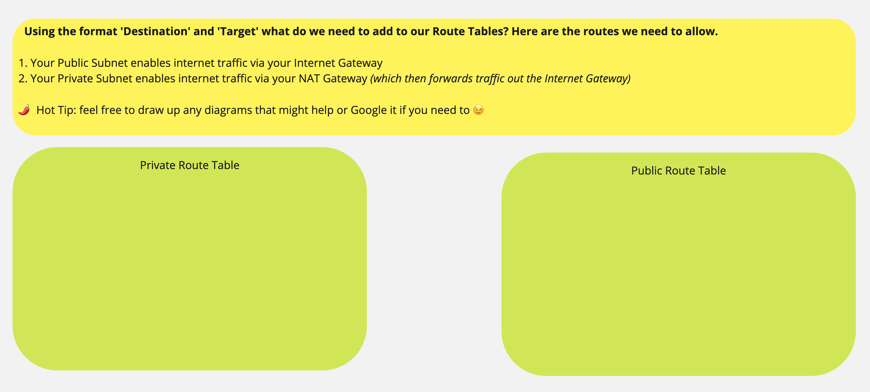
Activity!

